Slide 1
COMP 2230
Week 9 - Wednesday

Slide 2
Last time
Multiplication rule
Addition rule
Started pigeonhole principle

Slide 3
Questions?

Slide 4
Assignment 4

Slide 5
Logical warmup
Recall that a chessboard has 8 rows and 8 columns
You start on the upper left square of a chessboard
You are only allowed to move downwards or to the right, and can only move one square at a time
How many routes are there to the lower right square?

Slide 6
Pigeonhole Principle

Slide 7
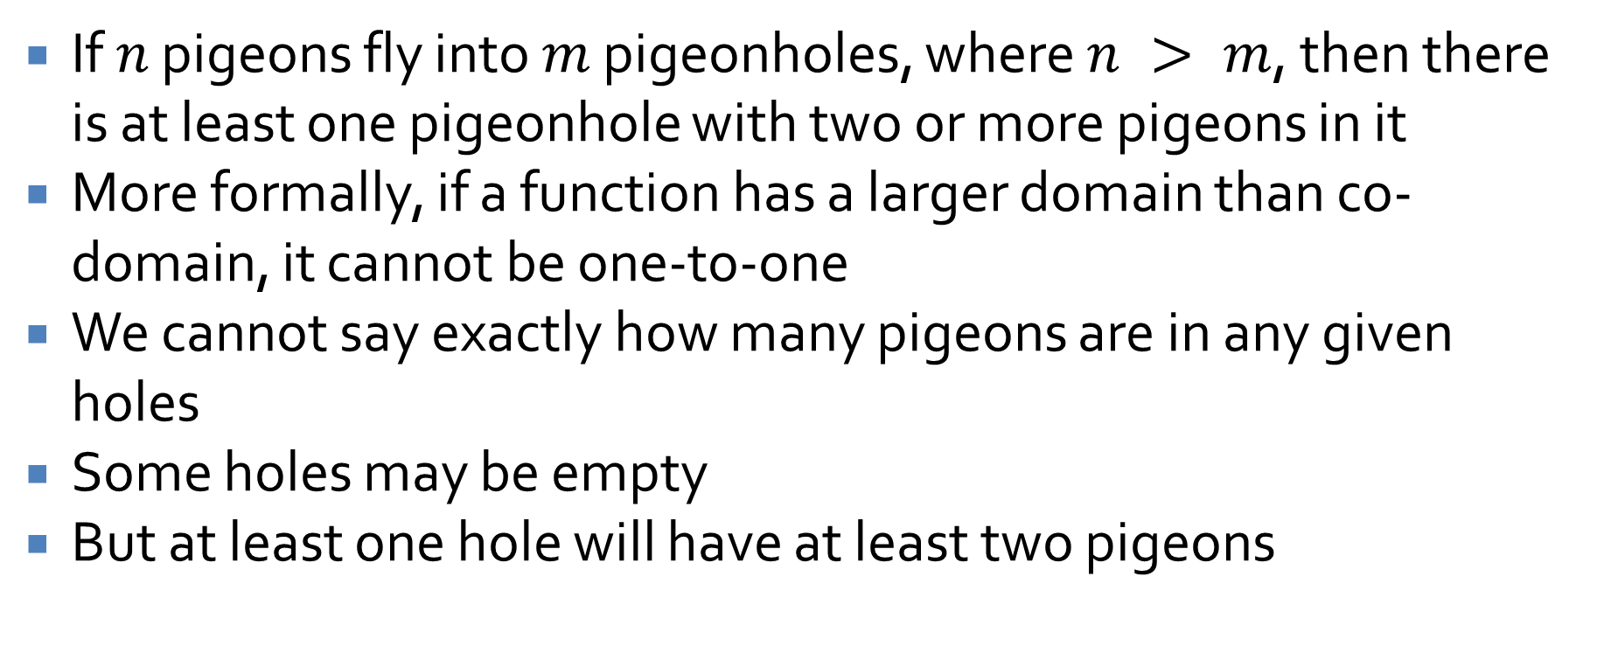
Pigeonhole principle
If $n$ pigeons fly into $m$ pigeonholes, where $n > m$, then there is at least one pigeonhole with two or more pigeons in it
More formally, if a function has a larger domain than co-domain, it cannot be one-to-one
We cannot say exactly how many pigeons are in any given holes
Some holes may be empty
But at least one hole will have at least two pigeons

Slide 8
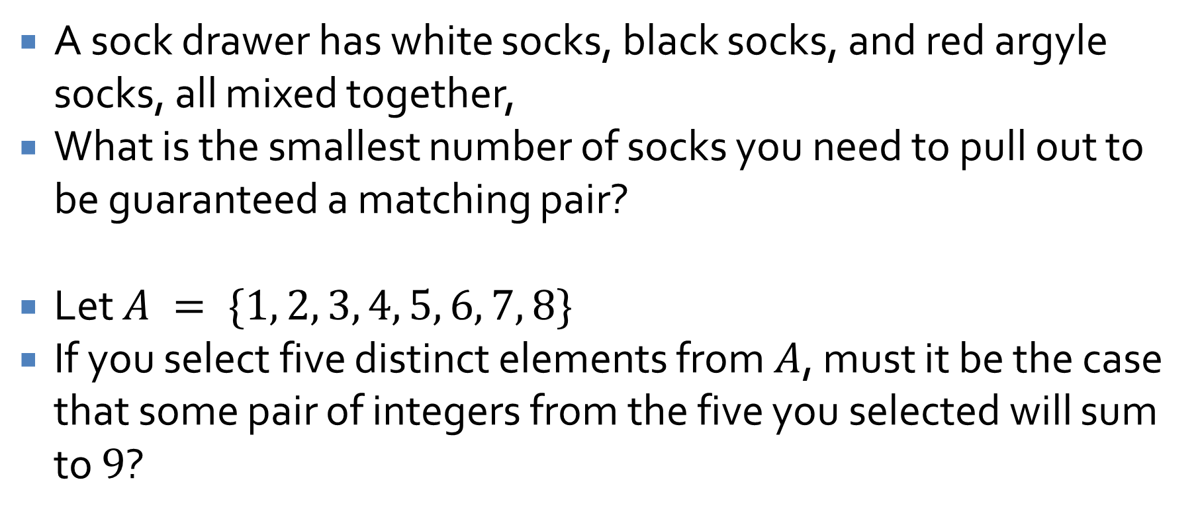
Pigeonhole examples
A sock drawer has white socks, black socks, and red argyle socks, all mixed together,
What is the smallest number of socks you need to pull out to be guaranteed a matching pair?
Let $A = \{1, 2, 3, 4, 5, 6, 7, 8\}$
If you select five distinct elements from $A$, must it be the case that some pair of integers from the five you selected will sum to $9$?

Slide 9
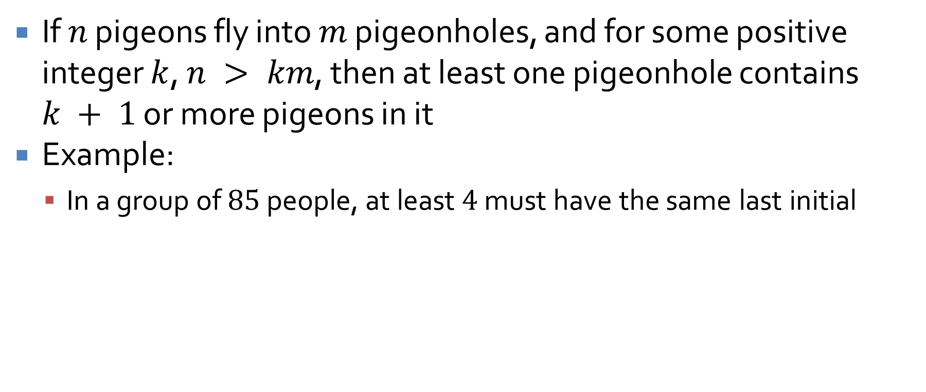
Generalized pigeonhole principle
If $n$ pigeons fly into $m$ pigeonholes, and for some positive integer $k$, $n > km$, then at least one pigeonhole contains $k + 1$ or more pigeons in it
Example:
  In a group of $85$ people, at least $4$ must have the same last initial

Slide 10
Combinations

Slide 11
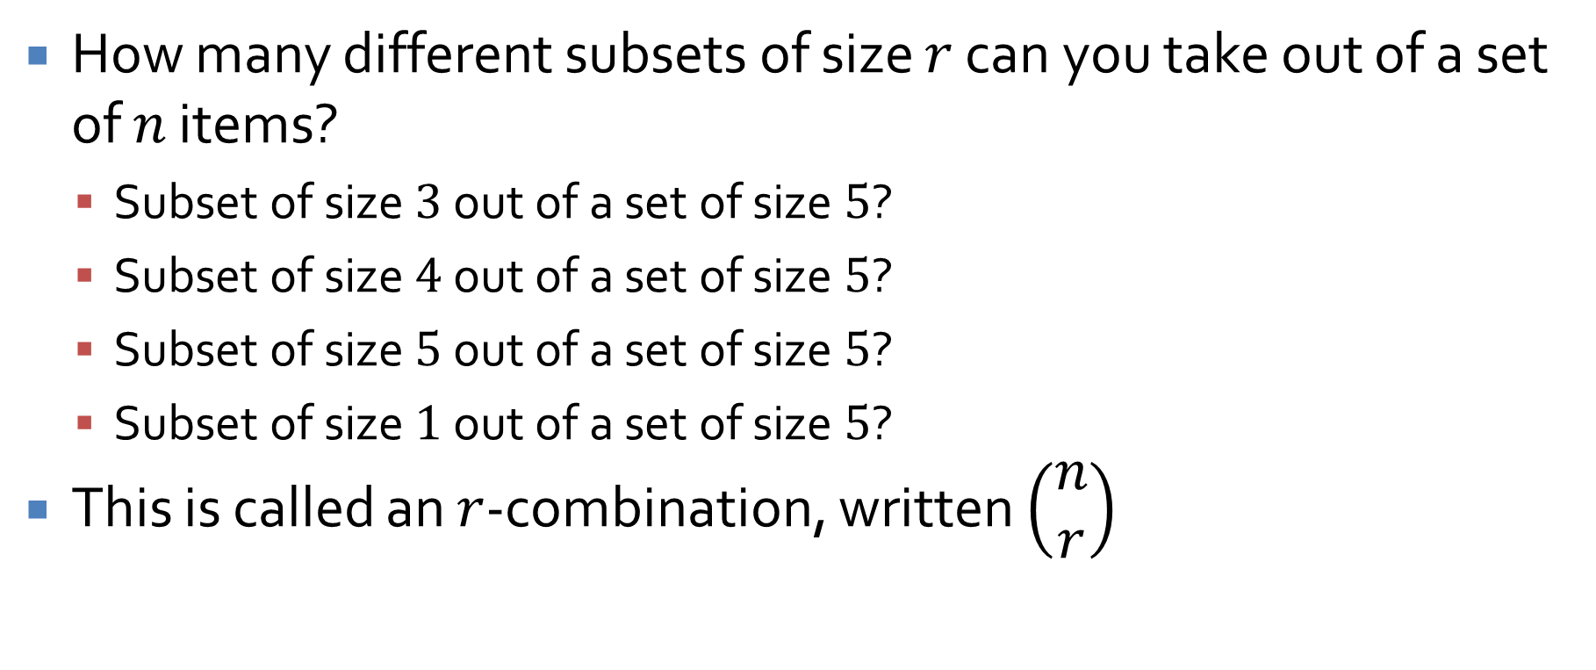
Subsets of sets
How many different subsets of size $r$ can you take out of a set of $n$ items?
  Subset of size $3$ out of a set of size $5$?
  Subset of size $4$ out of a set of size $5$?
  Subset of size $5$ out of a set of size $5$?
  Subset of size $1$ out of a set of size $5$?
This is called an $r$-combination, written $\left(\begin{matrix}n \\ r\end{matrix}\right)$

Slide 12
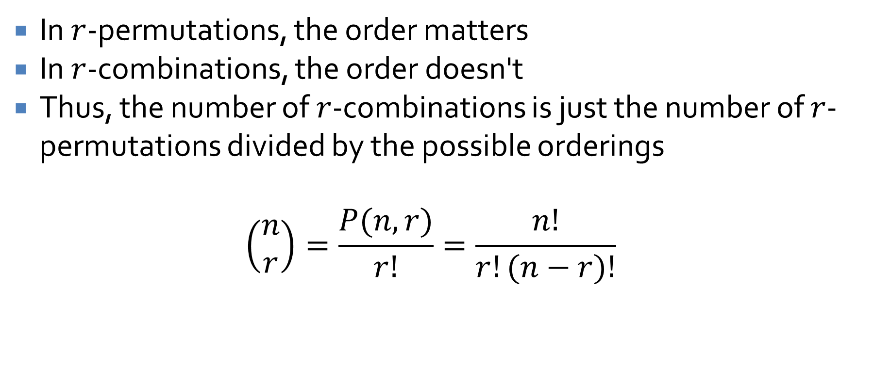
Permutations and combinations
In $r$-permutations, the order matters
In $r$-combinations, the order doesn't
Thus, the number of $r$-combinations is just the number of $r$-permutations divided by the possible orderings
$$\left(\begin{matrix}n \\ r\end{matrix}\right)=\frac{P(n,r)}{r!}=\frac{n!}{r!(n−r)!}$$

Slide 13
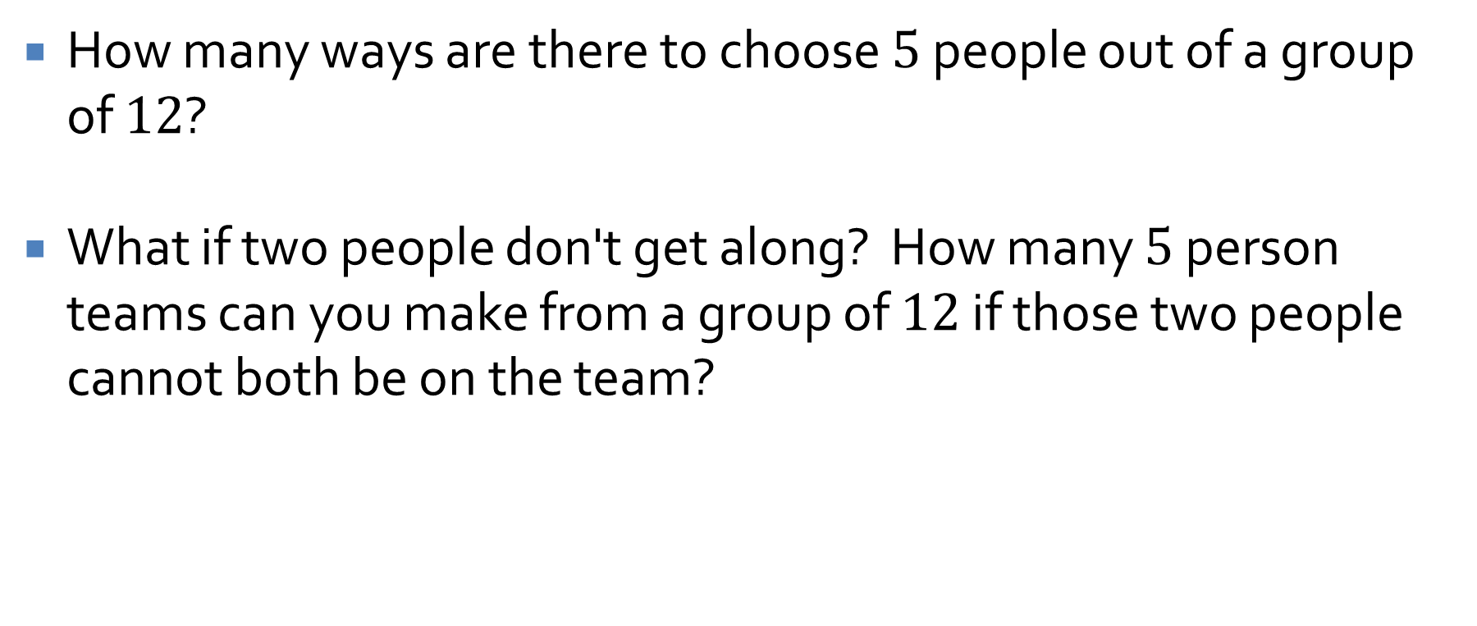
Combinations example
How many ways are there to choose $5$ people out of a group of $12$?
What if two people don't get along? How many $5$ person teams can you make from a group of $12$ if those two people cannot both be on the team?

Slide 14
Poker examples
How many five-card poker hands contain two pairs?
If a five-card hand is dealt at random from an ordinary deck of cards, what is the probability that the hand contains two pairs?

Slide 15
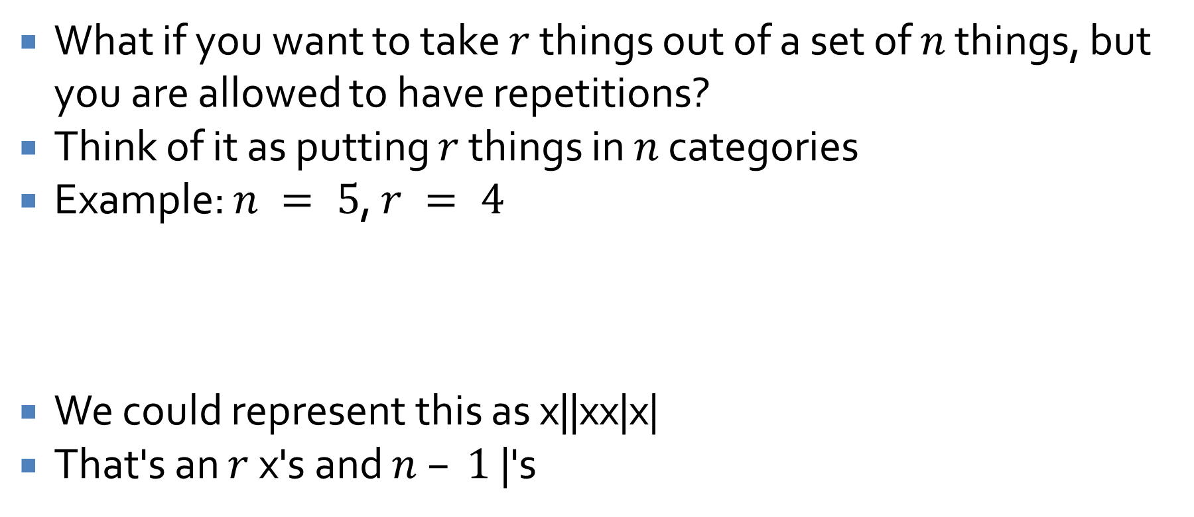

$r$-combinations with repetitions
What if you want to take $r$ things out of a set of $n$ things, but you are allowed to have repetitions?
Think of it as putting $r$ things in $n$ categories
Example: $n = 5$, $r = 4$
We could represent this as x||xx|x|
That's an $r$ x's and $n – 1$ |'s
1 | 2 | 3 | 4 | 5
x |  | xx | x

Slide 16
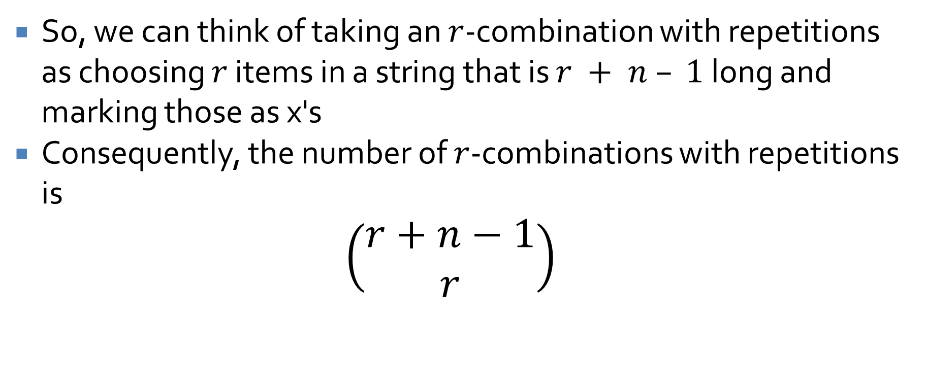
$r$-combinations with repetitions
So, we can think of taking an $r$-combination with repetitions as choosing $r$ items in a string that is $r + n – 1$ long and marking those as x's
Consequently, the number of $r$-combinations with repetitions is
$$\left(\begin{matrix}r+n−1 \\ r\end{matrix}\right)$$

Slide 17
Example
Let's say you grab a handful of 10 Starbursts
Original Starbursts come in
  Cherry
  Lemon
  Strawberry
  Orange
How many different handfuls are possible?
How many possible handfuls will contain at least 3 cherry?

Slide 18
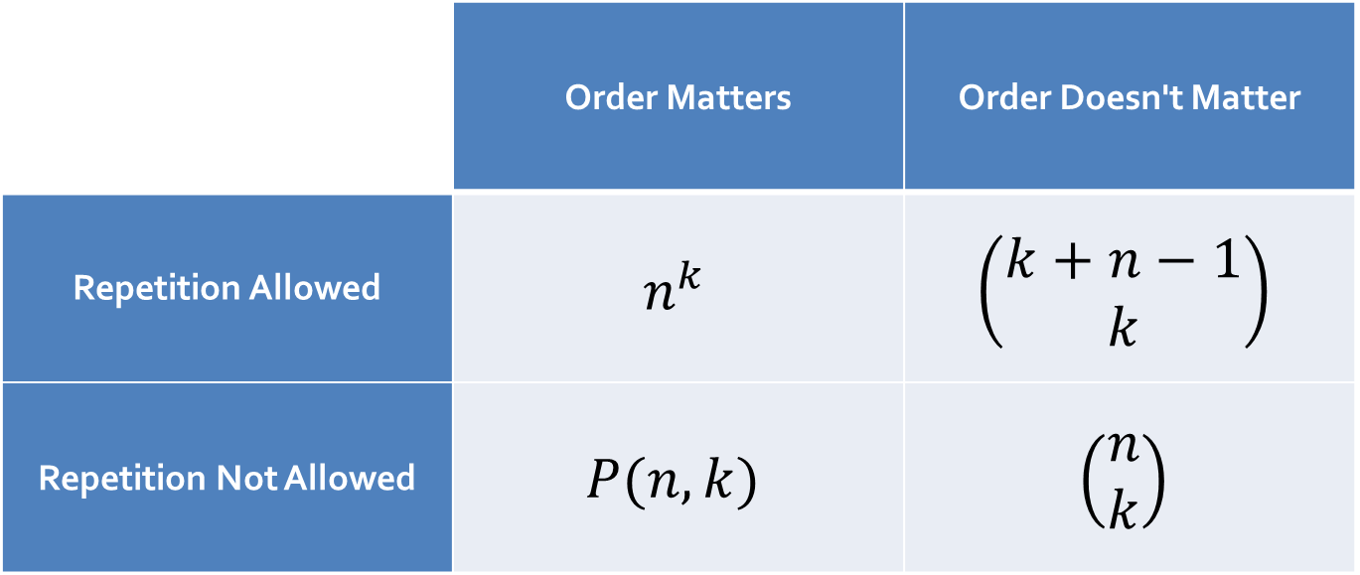
Handy dandy guide to counting
This is a quick reminder of all the different ways you can count things:
 | Order Matters | Order Doesn't Matter
Repetition Allowed | $$n^{k}$$ | $$\left(\begin{matrix}k+n−1 \\ k\end{matrix}\right)$$
Repetition Not Allowed | $$P(n,k)$$ | $$\left(\begin{matrix}n \\ k\end{matrix}\right)$$

Slide 19
Binomial Theorem and Expected Value
Three-Sentence Summary

Slide 20
Binomial Matters

Slide 21

Pascal's Triangle
Hopefully, you're all familiar with Pascal's Triangle, the beginning of which is:
If we number rows and columns starting at $0$, note that the value of row $n$, column $r$ is exactly $\left(\begin{matrix}n \\ r\end{matrix}\right)$
1
1 | 1
1 | 2 | 1
1 | 3 | 3 | 1
1 | 4 | 6 | 4 | 1
1 | 5 | 10 | 10 | 5 | 1
1 | 6 | 15 | 20 | 15 | 6 | 1

Slide 22
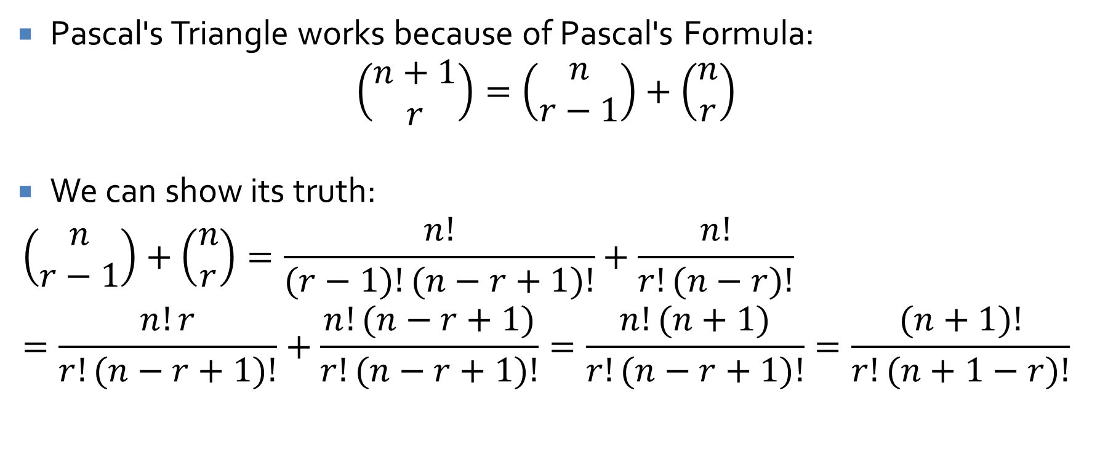
Pascal's Formula
Pascal's Triangle works because of Pascal's Formula:
$$\left(\begin{matrix}n+1 \\ r\end{matrix}\right)=\left(\begin{matrix}n \\ r−1\end{matrix}\right)+\left(\begin{matrix}n \\ r\end{matrix}\right)$$
We can show its truth:
$$\left(\begin{matrix}n \\ r−1\end{matrix}\right)+\left(\begin{matrix}n \\ r\end{matrix}\right)=\frac{n!}{(r−1)!(n−r+1)!}+\frac{n!}{r!(n−r)!} \\ =\frac{n!r}{r!(n−r+1)!}+\frac{n!(n−r+1)}{r!(n−r+1)!}=\frac{n!(n+1)}{r!(n−r+1)!}=\frac{(n+1)!}{r!(n+1−r)!}$$

Slide 23
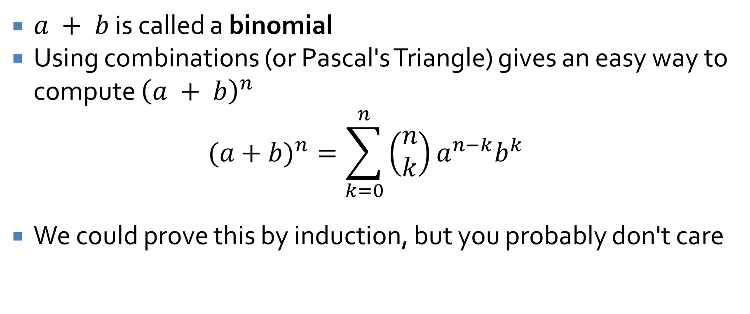
Binomial Theorem
$a + b$ is called a binomial
Using combinations (or Pascal's Triangle) gives an easy way to compute ${\left(a + b\right)}^{n}$
$$(a+b)^{n}=\sum_{k=0}^{n}{\left(\begin{matrix}n \\ k\end{matrix}\right)}a^{n−k}b^{k}$$
We could prove this by induction, but you probably don't care

Slide 24

Binomial Example
Compute ${\left(1 – x\right)}^{6}$ using the binomial theorem

Slide 25
Ticket Out the Door

Slide 26
Upcoming

Slide 27
Next time…
Conditional probability

Slide 28
Reminders
Keep working on Assignment 4
  Due Friday
Read 9.9
  Prepare a three-sentence summary
  Extra credit if you get called on

